Slide 1
Chapter 4. Differentiation and integration

Slide 2
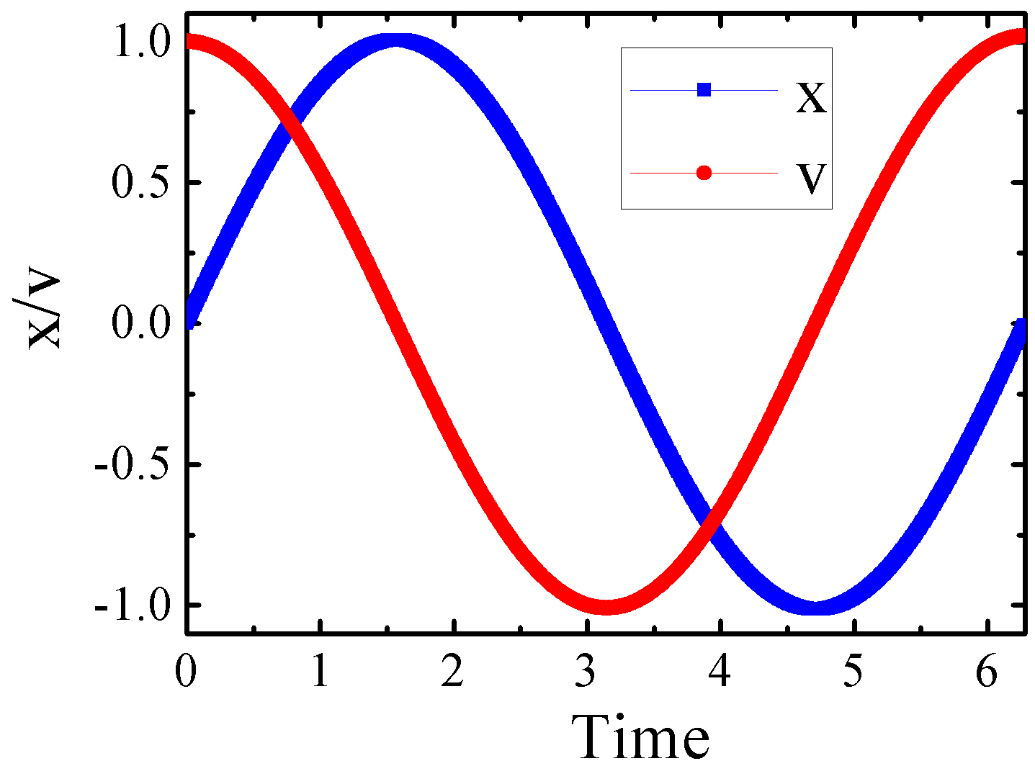
Numerical calculus
derivative
x
position
derivative
v
velocity
a
acceleration
integral
integral

Slide 3
Taylor’s Expansion
Numerical differentiation

Slide 4
Forward Difference Formula for
Geometrically
h

Slide 5
Backward Difference Formula for
Similarly
Geometrically
h

Slide 6
Central Difference Formula for
–)

Slide 7
Central Difference Formula for
Geometrically
2h

Slide 8
Example
,
Calculate f’(1) using FD, BD, CD

Slide 9
Example (cont)
FD:
h=0.1
h=0.05
BD:
h=0.1
h=0.05
CD:
h=0.1
h=0.05

Slide 10
Example (cont)
Remarks:
FD, BD, CD each involves 2 function calls, 1 subtraction, and 1 division: same computation time
CD is the most accurate (hence, the most recommended method)

Slide 11
A five-point formula can be derived by including the expansions of f_{i+2} and f_{i-2} around x_{i}.
(1)
(2)

Slide 12
number of points | inaccuracy
2 (FD, BD) | O(h)
3 (CD) | O(h²)
5 (five-point) | O(h⁴)
More points
Higher accuracy
Smaller h

Slide 13
Forward Difference Formula for
–2×）

Slide 14
Backward Difference Formula for
–2×）

Slide 15
Central Difference Formula for
+)
Similar remark on the selection of FD|BD|CD applies for f”(x)

Slide 16
Similarly, we can combine the expansions of f_{i±2} and f_{i±1} around x_{i} and f_{i} to cancel the f'_{i} , f ⁽³⁾_{i} , f ⁽⁴⁾_{i} , and f ⁽⁵⁾ _{i} terms; then we have
the five-point formula for the second-order derivative

Slide 17
Can one use the interpolation method to estimate derivative?

Slide 18
Richardson Extrapolation
Idea:
exact
= computed+ error
The truncation error is of the form: ch^{k}
where c is some constant
Use different h to estimate the truncation error
Use extrapolation to get more accurate result

Slide 19
Richardson Extrapolation (cont)
Example: CD for f '(x)
Using Different h (h₁, h₂)：
c₁ and c₂ could be different

Slide 20
Richardson Extrapolation (cont)
If

Slide 21
Example
f(x) = x³. Use CD with Richardson extrapolation to compute f '(1)
Magic?
Coincidence?

Slide 22
Revisit CD Formula for
–)
Change notation:

Slide 23
Error Analysis
Assuming
Eliminate a₁ to get better accuracy

Slide 24
Error Analysis (cont)
4×
–)
O(h⁴)

Slide 25
Revisit Previous Example
f(x) = x³. Use CD with Richardson extrapolation to compute f’(1)
a₂ involves f⁽⁵⁾(x), hence, the exact solution is no surprise.

Slide 26
Remark
How much effort did we use to get this level of accuracy?
F(h): f(x+h), f(x-h); one –, one ÷
F(h/2): f(x+h/2), f(x-h/2); one –, one ÷
R.E.: two ×, one –

Slide 27
Richardson Extrapolation: General discussion
Assuming the higher derivatives exist, we can hold x fixed (which also fixes the values of f(x)), to obtain the following formula.
Richardson Extrapolation examines the operator below as a function of h.

Slide 28
先消去a₂
4 Eq(2)- Eq(1):
4 Eq(3)- Eq(2):

Slide 29
消去b₄ (a₄)
16 Eq(5)- Eq(4):

Slide 30
Richardson extrapolation: general formula
Consider the following property:
where L is unknown,
as are the coefficients, a_{2k}.

Slide 31
Do not forget the formal definition is simply the central-differences formula:
New symbology:
From previous slide

Slide 32
D(n,0) is just the central differences operator for different values of h.
Okay, so we proceed by computing D(n,0) for several values of n.
Recalling our cancellation of the h² term.

Slide 33
If we let h→h/2^{n}, then in general, we can write:
Let’s denote this operator as:

Slide 34
Now, we can formally define Richardson’s extrapolation operator as:
or
new estimate
old estimate

Slide 35
Richardson Extrapolation Formula
Now, we can formally define Richardson’s extrapolation operator as:
Memorize me!!!!

Slide 36
Richardson Extrapolation Theorem
These terms approach f’(x) very quickly.
Order starts much higher!!!!

Slide 37
Since m≤ n, this leads to a two-dimensional triangular array of values as follows:
We must pick an initial value of h and a max iteration value N.

Slide 38
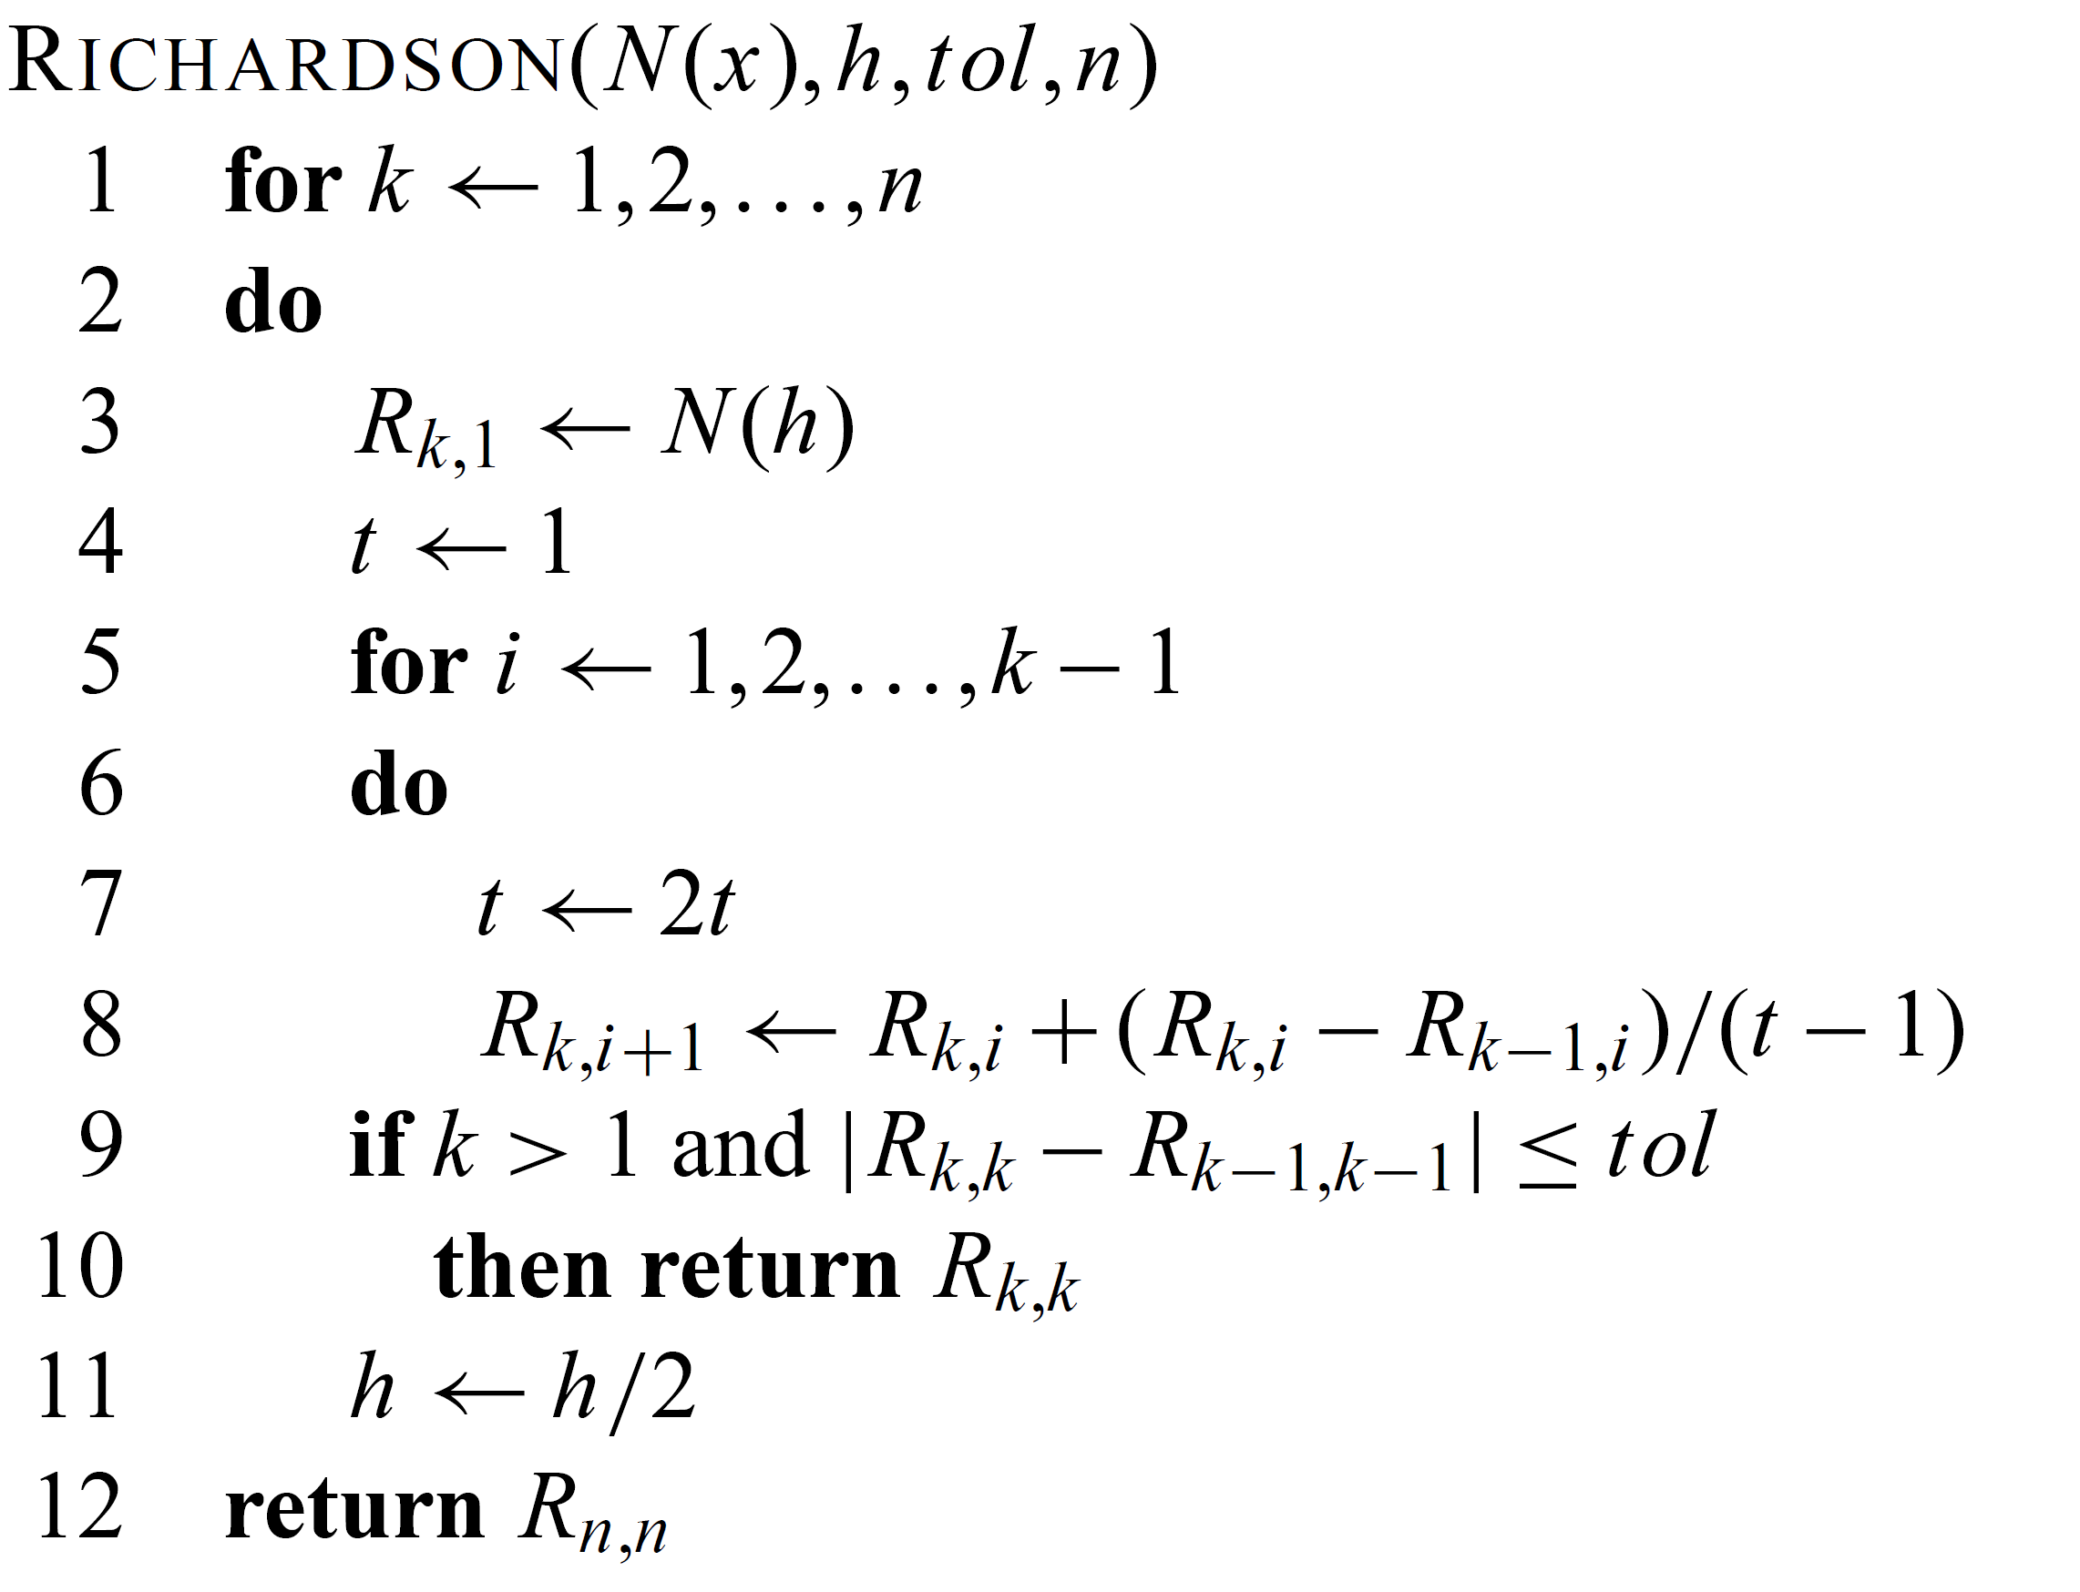
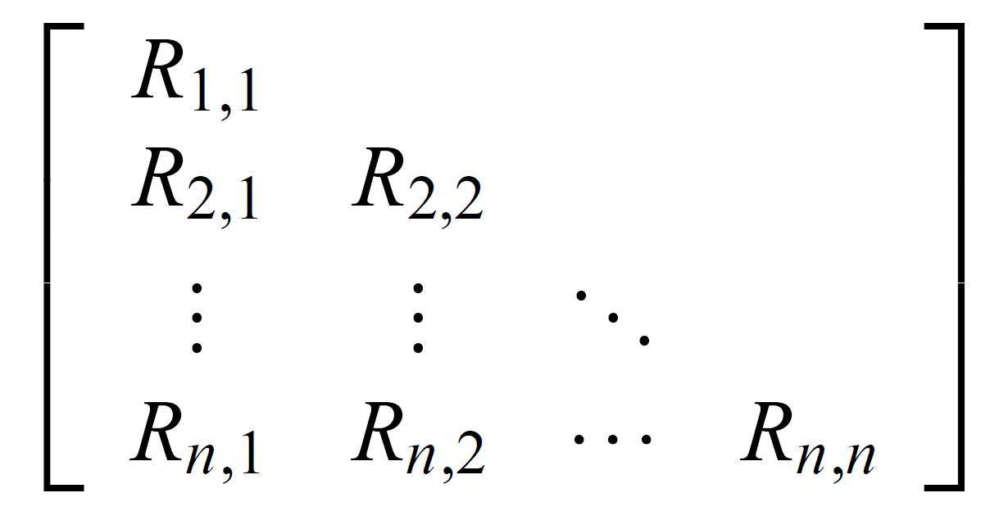
Pseudocode for Richardson extrapolation algorithm
4t

Slide 39
Example

Slide 40
Example

Slide 41
Example

Slide 42
Example
Which converges up to eight decimal places.
Is it accurate?

Slide 43
Example
We can look at the (theoretical) error term on this example.
Taking the derivative:
2⁻¹⁴⁴
Round-off error

Slide 44
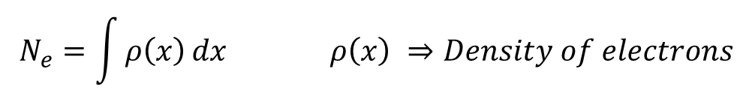
Numerical Integration
Why we need numerical integration?
Numerical integration has been very important, even long before the appearance of computer.
• Many complicate function can not be integrated analytically.
Numerically method becomes the only way to get an answer.
• Many physical quantities are given in discrete form instead of
continuous form, thus the integrations and derivatives can only be
obtained using numerical method.
e.g. In ab initio calculation, we need to calculate:
$$N_{e}=\int{ρ\left(x\right)}dx ρ\left(x\right) ⇒Density of electrons$$

Slide 45
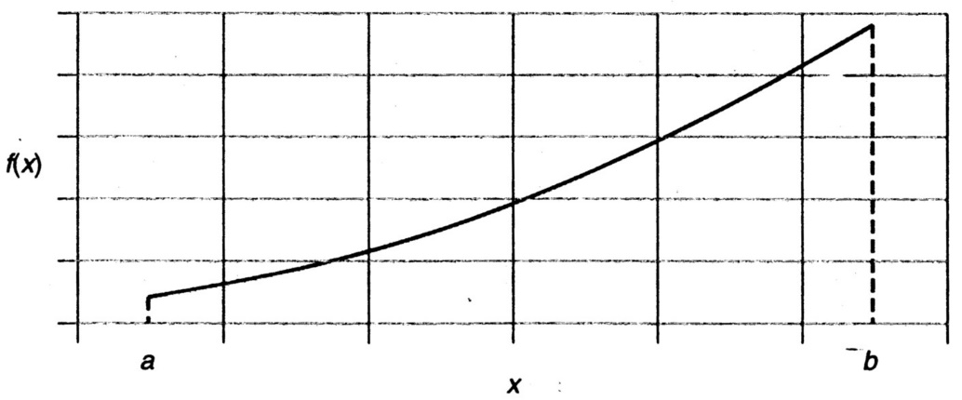
Numerical Integration
The area under the curve f(x) between x=a and x=b:
Example: the volume rate of flow (Q) of water in a channel or through a pipe is the integral of the velocity (V) and the incremental area (dA):

Slide 46
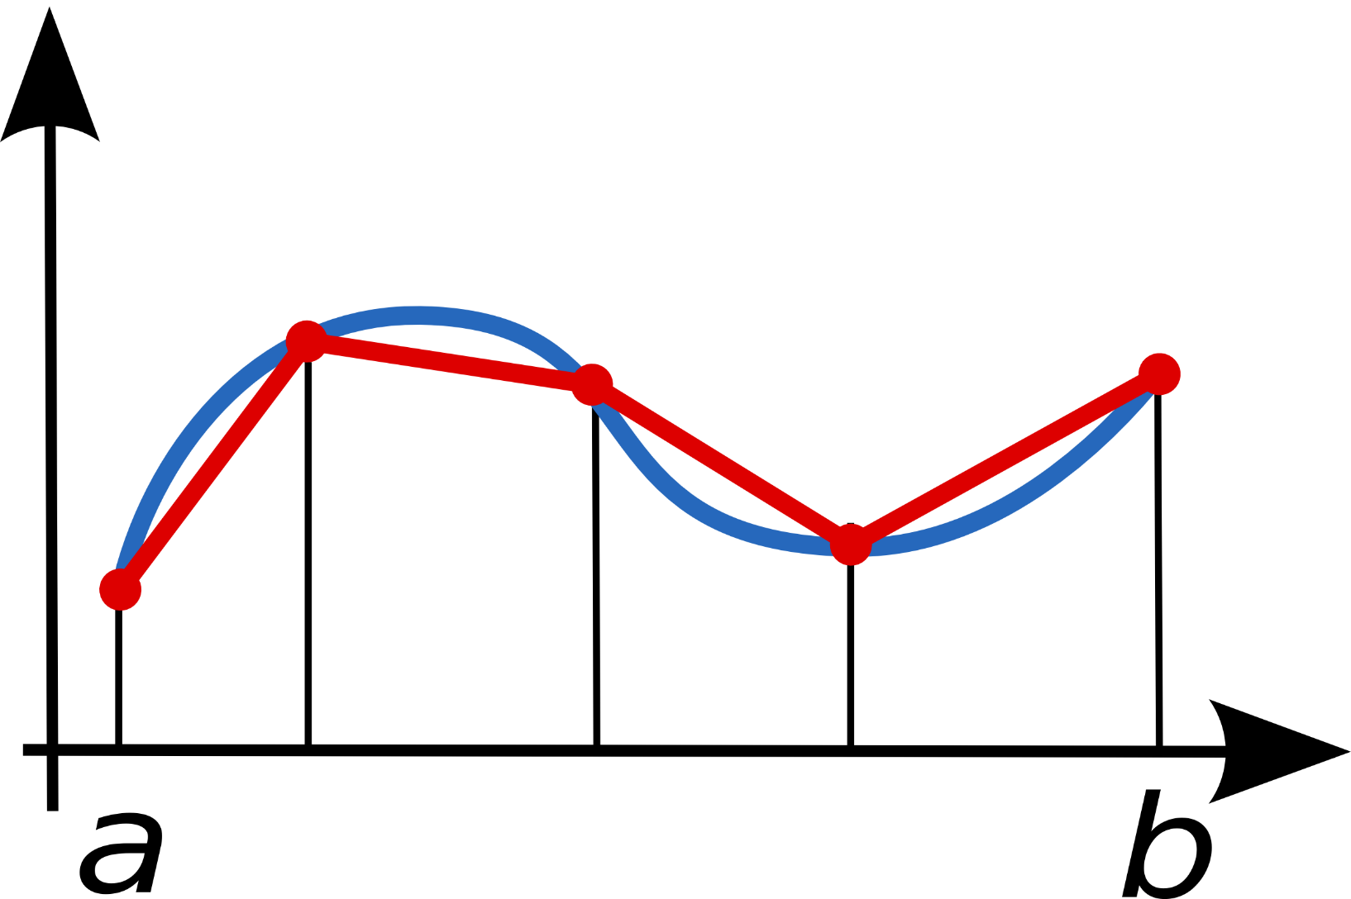
Trapezoidal rule

Slide 47
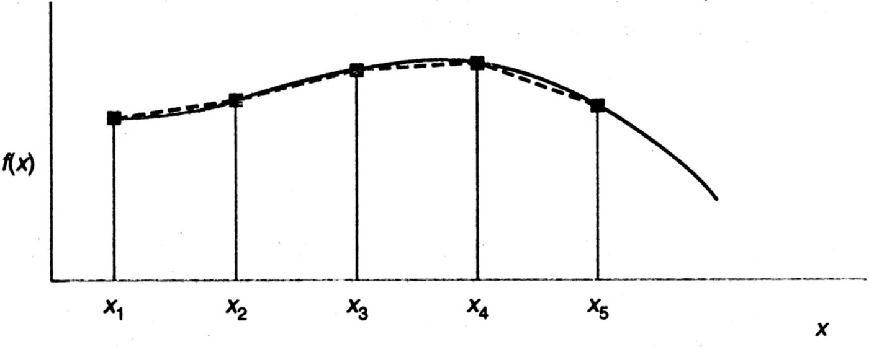
Trapezoidal Rule
h
h

Slide 48
Another way to get the trapezoidal formula
The linear polynomial passing the data points:

Slide 49
The absolute value of the upper bound on the error for the Trapezoidal rule is:
Trapezoidal rule gives exact results for linear polynomials

Slide 50
Trapezoidal Rule Error Analysis
How accurate is this approximation?
Start with Taylor series for f (x) around a

Slide 51
Trapezoidal Rule Error Analysis
Expand LHS:
Expand RHS

Slide 52
Trapezoidal Rule Error Analysis-2
f(x)
Error in linear interpolation
a
b

Slide 53
Trapezoidal Rule Error Analysis
In general, error for a single segment proportional to h³
Error for subdividing entire a→b interval proportional to h²
“Cubic local accuracy, quadratic global accuracy”

Slide 54
Example: Trapezoidal Rule for Integration
n = 4
The trapezoidal rule provides

Slide 55
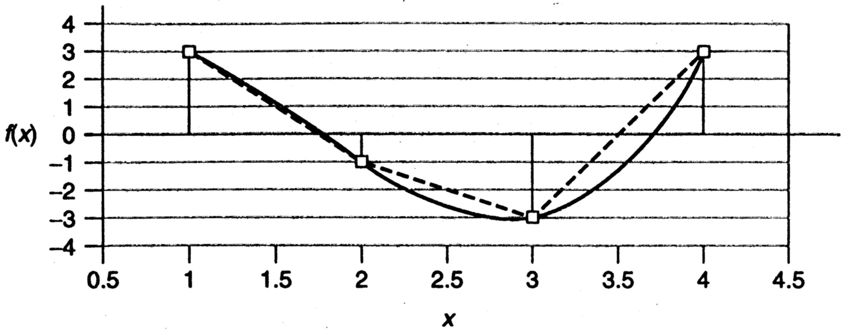

Slide 56
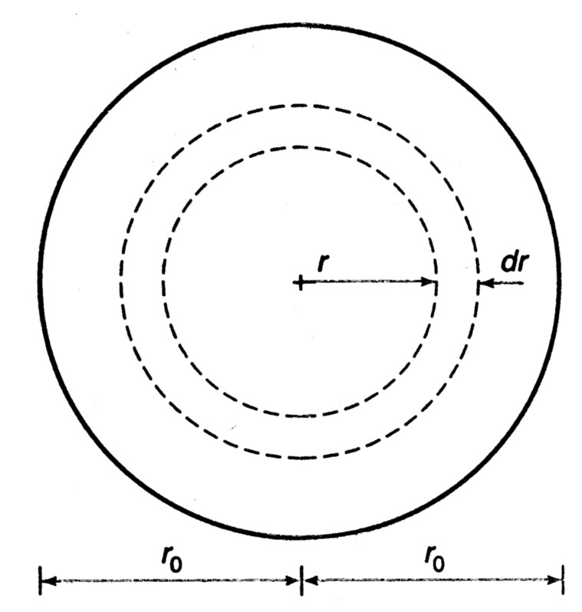
Example: Flow Rate
The flow rate (Q) of an incompressible fluid is given by the integral.
in which V is the velocity and A is the area.
For a circular pipe of radius r, the incremental area dA is equal to 2πrdr.

Slide 57
Table 1: The Data for Estimating the Flow Rate of a Fluid in a Circular Piple
i | r_{i} (ft) | V_{i} (fps)
1 | 0 | 10.000
2 | 1/12 | 9.722
3 | 1/6 | 8.889
4 | 1/4 | 7.500
5 | 1/3 | 5.556
6 | 5/12 | 3.056
7 | 1/2 | 0.

Slide 58
For a pipe of diameter of 1 ft
trapezoidal rule:

Slide 59
Simpson’s Rule
Simpson’s rule:
where
Simpson’s rule can only be applied when there are an even number of subintervals:

Slide 60
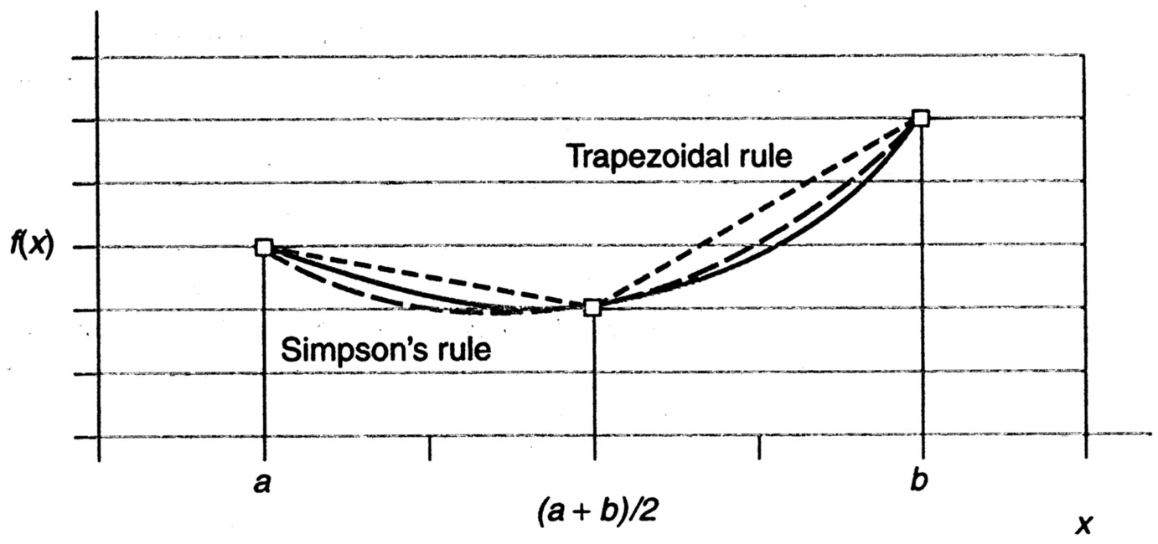
Proof of Simpson’s Rule
Using a second-order polynomial to interpolate the function

Slide 61
Using the Lagrange form for a quadratic fit of three points: Integration over the three points simplifies to:

Slide 62
The absolute value of the upper bound on the error for the Simpson’s rule is estimated by
Simpson’s rule gives exact results for third-order polynomials

Slide 63
Understand Error in Simpson’s Rule
Odd function

Slide 64
Example: Flow Rate Problem
Applying Simpson’s rule to the data of Table.1

Slide 65
Romberg Integration
Step 1: estimate integral with different h
Denoting the trapezoidal estimate as I₀₀
where a and b are the start and end of an interval.
A second estimate I₁₀:

Slide 66
A third estimate I₂₀ can be obtained using three equally spaced intermediate points m₁, m₂, and m₃
and it can be rewritten as
Continuing this subdividing of the interval leads to the following recursive relationship

Slide 67
Romberg Integration
Step 2: Richardson extrapolation
j : level of subdivision, j+1 has more intervals.
k : level of integration, k = 0 is original trapezoid estimate [O(h²)], k = 1 is improved [O(h⁴)], etc.
Compare with the formula for differentiation

Slide 68
Romberg Integration
For example, j = 1, k = 1 leads to

Slide 69
Example
Consider the function:
Integrate from a = 0 to b = 0.8
Using the trapezoidal rule yields the following results:

Slide 70
Example
Trapezoid Rules:
k = 0
k = 1
k
j
j = 0
j = 1
j = 2
(j=1, k=1)
Exact integral is 1.64053334

Slide 71
Example
k
k = 0
k = 1
j
j = 0
j = 1
j = 2
(j=2, k=1)
Exact integral is 1.64053334

Slide 72
Example
k
k = 0
k = 1
j
j = 0
j = 1
j = 2
(j=2, k=2)
Exact integral is 1.64053334

Slide 73
Example
k
k = 0
k = 1
k = 2
j
j = 0
j = 1
j = 2
Exact integral is 1.64053334

Slide 74
Romberg Integration
Is this that significant?
Consider the cost of computing the Trapezoid Rule for 1000 data points.
Refinement would lead to 2000 data points.
Implies an additional 1003 operations using the Recursive Trapezoid Rule.
Not to mention the 1000 (expensive) function evals.
Romberg Integration cost:
Three additional operations – no function evals!!!

Slide 75
Gauss Quadrature
The idea is that if we evaluate the function at certain points (non-uniformly distributed), and sum with certain weights, we will get accurate integral
Evaluation points and weights are tabulated

Slide 76
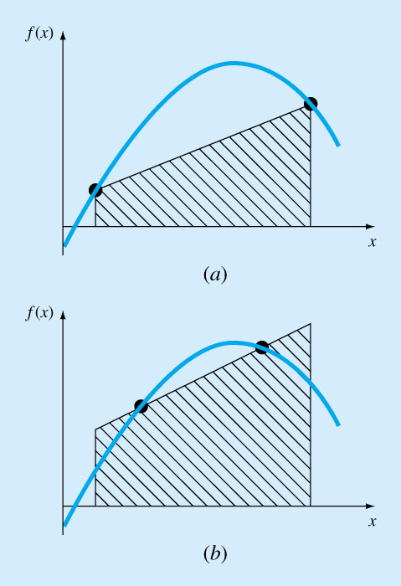
Trapezoidal vs. Gauss-Quadrature
Trapezoidal
Gauss-Quadrature
Exact for constant and linear functions
Exact for constant, linear, quadratic and cubic functions

Slide 77
Gauss quadrature
Weight
Integration point
How can we choose the integration points and weights to exactly integrate a polynomial of degree 2M-1?
Remember that now we do not know, a priori, the location of the integration points.

Slide 78
Example: M=1 (Midpoint qudrature)
How can we choose W₁ and ξ₁ so that we may integrate a
(2M-1=1) linear polynomial exactly?
But we want

Slide 79
Hence, we obtain the identity
For this to hold for arbitrary a₀ and a₁ we need to satisfy 2 conditions
i.e.,

Slide 80
For M=1
f(ξ)
f(0)
g(ξ)
ξ
-1
1
Midpoint quadrature rule:
Only one evaluation of f(ξ) is required at the midpoint of the interval.
Scheme is accurate for constants and linear polynomials (compare with Trapezoidal rule)

Slide 81
Example: M=2
How can we choose W₁,W₂, ξ₁ and ξ₂ so that we may integrate a polynomial of degree (2M-1=4-1=3) exactly?
But we want

Slide 82
Hence, we obtain the 4 conditions to determine the 4 unknowns (W₁ ,W₂, ξ₁ and ξ₂ )
Check that the following is the solution

Slide 83
For M=2
f(ξ)
*
*
ξ
-1
1
Only two evaluations of f(ξ) is required.
Scheme is accurate for polynomials of degree at most 3 (compare with Simpson’s rule)
Simpson’s rule: Exact for polynomial up to ___ order?

Slide 84
Example
Exact integration
Integrate and check!
Gauss
To exactly integrate this I need a 2-point Gauss formula. Why?

Slide 85
Gauss quadrature:
Exact answer!

Slide 86
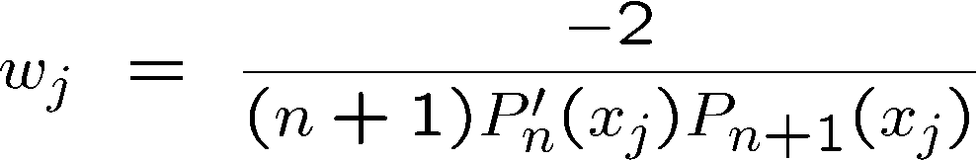
Gaussian Quadrature: high order
Gaussian quadrature approximates the integral of a function on [-1, 1] as
Here the abscissas x_{j} are the roots of the Legendre polynomial P_{n}(x) and the weights w_{j} are given by
Gaussian quadrature is the best integration scheme for continuous, well-behaved functions at moderate levels of precision (< 1000 digits).
The first few Legendre polynomials:

Slide 87
Arguments and Weighing Factors for n-point Gauss Quadrature Formulas
Table 1: Weighting factors c and function arguments x used in Gauss Quadrature Formulas.
In handbooks, coefficients and
arguments given for n-point
Points | Weighting Factors | Function Arguments
2 | c₁ = 1.000000000 c₂ = 1.000000000 | x₁ = -0.577350269 x₂ = 0.577350269
3 | c₁ = 0.555555556 c₂ = 0.888888889 c₃ = 0.555555556 | x₁ = -0.774596669 x₂ = 0.000000000 x₃ = 0.774596669
4 | c₁ = 0.347854845 c₂ = 0.652145155 c₃ = 0.652145155 c₄ = 0.347854845 | x₁ = -0.861136312 x₂ = -0.339981044 x₃ = 0.339981044 x₄ = 0.861136312
Gauss Quadrature Rule are
given for integrals
as shown in Table 1.

Slide 88
Arguments and Weighing Factors for n-point Gauss Quadrature Formulas
Table 1 (cont.) : Weighting factors c and function arguments x used in Gauss Quadrature Formulas.
Points | Weighting Factors | Function Arguments
5 | c₁ = 0.236926885 c₂ = 0.478628670 c₃ = 0.568888889 c₄ = 0.478628670 c₅ = 0.236926885 | x₁ = -0.906179846 x₂ = -0.538469310 x₃ = 0.000000000 x₄ = 0.538469310 x₅ = 0.906179846
6 | c₁ = 0.171324492 c₂ = 0.360761573 c₃ = 0.467913935 c₄ = 0.467913935 c₅ = 0.360761573 c₆ = 0.171324492 | x₁ = -0.932469514 x₂ = -0.661209386 x₃ = -0.2386191860 x₄ = 0.2386191860 x₅ = 0.661209386 x₆ = 0.932469514

Slide 89
Change integration variable
So if the table is given for
integrals, how does one solve
?
The answer lies in that any integral with limits of
can be converted into an integral with limits
Let
If then
Such that:
If then

Slide 90
Then
Hence
Substituting our values of x, and dx into the integral gives us

Slide 91
Example
a)
Use two-point Gauss Quadrature Rule to approximate the distance
covered by a rocket from t=8 to t=30 as given by
Find the true error, for part (a).
Also, find the absolute relative true error, for part (a).
b)
c)

Slide 92
Solution
First, change the limits of integration from [8,30] to [-1,1]
by previous relations as follows

Slide 93
Solution (cont)
Next, get weighting factors and function argument values from Table 1
for the two point rule,

Slide 94
Solution (cont.)
Now we can use the Gauss Quadrature formula

Slide 95
Solution (cont)
since

Slide 96
Solution (cont)
b)
The true error, , is
c)
The absolute relative true error,
, is (Exact value = 11061.34m)

Slide 97
General Gauss Quadrature Rules
Solution: introduce different sets of orthogonal polynomials
For two functions and
defines a scalar product w.r.t. on the set .
A degree n polynomial and a degree m polynomial are orthogonal on w.r.t. if
Different pairs lead to different sets of orthogonal polynomials.

Slide 98
Standard Gauss Quadrature Rules
 |  | Orthogonal Polynomials | Quadrature Rule
 | 1 | Legendre | Gauss-Legendre
 |  | Chebychev | Gauss-Chebychev
 |  | Jacobi | Gauss-Jacobi
 |  | Laguerr | Gauss-Laguerr
 |  | Hermite | Gauss-Hermite

Slide 99
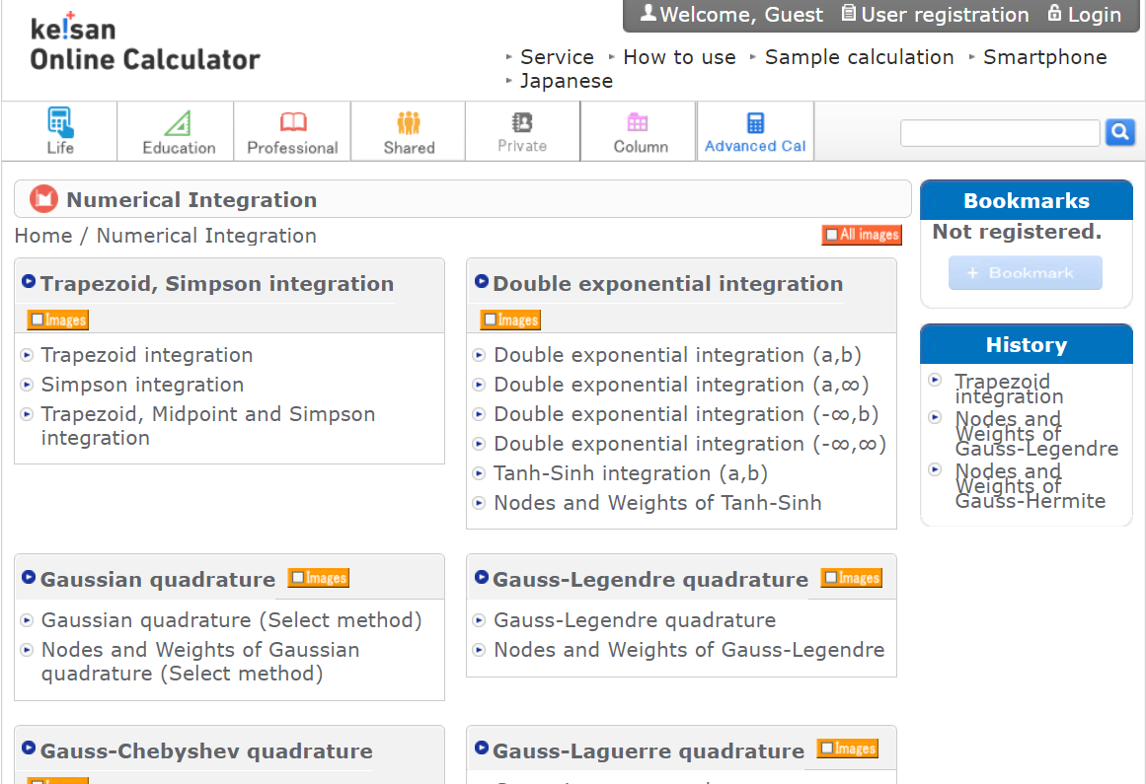
https://keisan.casio.com/menu/system/000000001110

Slide 100
Example: Gauss-Hermite quadrature
Gauss-Hermite quadrature nodes and weights
±1.22474487139 | 0.295408975151
0 | 1.1816359006
3-Point Gauss-Hermite quadrature
Polynomial exactness up to degree
±2.651961356 | 0.0009717812450
±1.673551628 | 0.05451558281
±0.8162878828 | 0.4256072526
0 | 0.8102646175
7-Point Gauss-Hermite quadrature
Polynomial exactness up to degree

Slide 101
Example: Gauss-Hermite quadrature
Suppose to evaluate
where
Variable transformation :

Slide 102
Example: Gauss-Hermite quadrature
Using quadrature nodes based on the weight function
we have
For special case

Slide 103
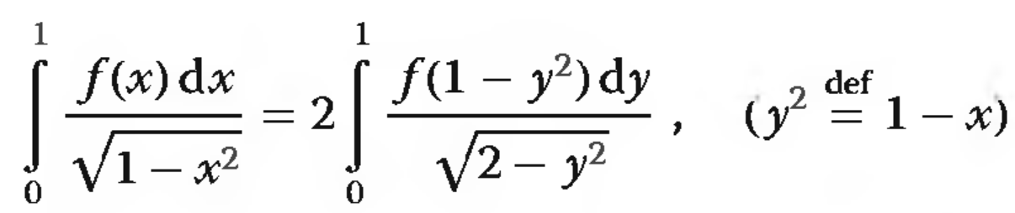
Avoid singularity
If an numerical integration contains singularity, first remove the singularity by hand.

Slide 104
Homework
1. Compute the derivative of f (x) = sin x at x = π/3 using the Richardson extrapolation algorithm. Start with h = 1 and find the number of rows in the Richardson table required to estimate the derivative with six significant decimal digits. Output the Richardson table.

Slide 105
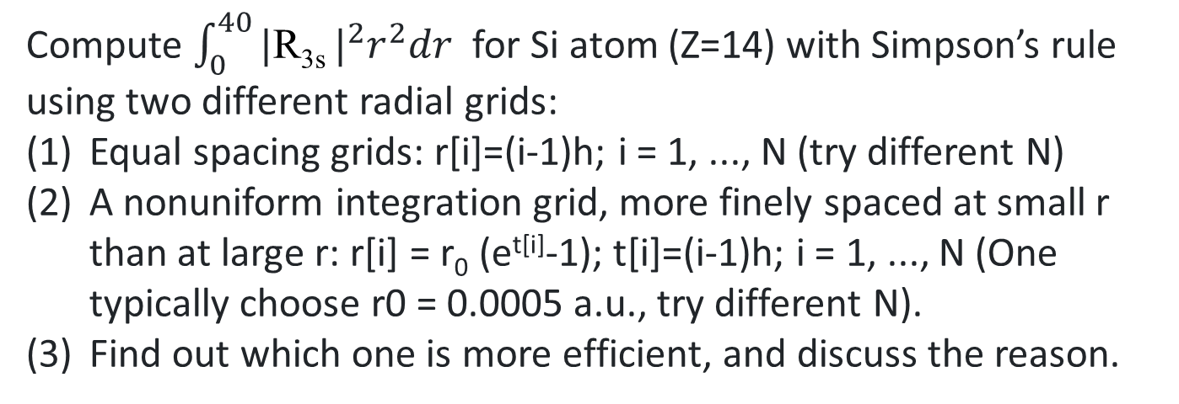
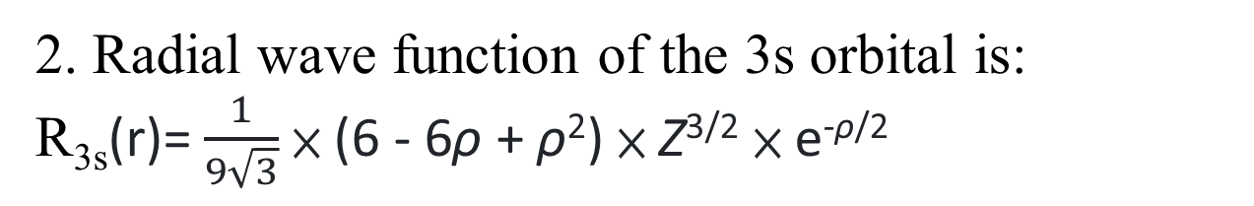
2. Radial wave function of the 3s orbital is:
R_{3s}(r)= $\frac{1}{9\sqrt{3}}$ × (6 - 6ρ + ρ²) × Z^{3/2} × e^{-ρ/2}
r = radius expressed in atomic units (1 Bohr radius = 52.9 pm)
e = 2.71828 approximately
Z = effective nuclear charge for that orbital in that atom.
ρ = 2Zr/n where n is the principal quantum number (3 for the 3s orbital)
Compute $\int_{0}^{40}{\text{|}\text{R}\text{3}\text{s}}|^{2}r^{2}dr$ for Si atom (Z=14) with Simpson’s rule using two different radial grids:
Equal spacing grids: r[i]=(i-1)h; i = 1, ..., N (try different N)
A nonuniform integration grid, more finely spaced at small r than at large r: r[i] = r₀ (e^{t[i]}-1); t[i]=(i-1)h; i = 1, ..., N (One typically choose r0 = 0.0005 a.u., try different N).
Find out which one is more efficient, and discuss the reason.

Slide 106
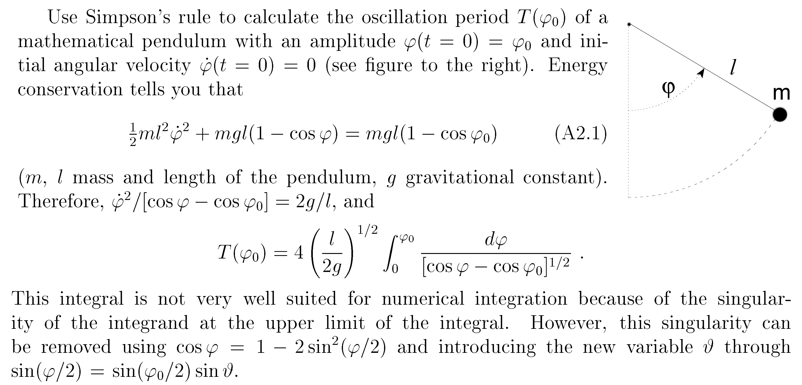
选做（不用交）

Slide 107
课题测验
1. 求右边矩阵的RREF（ ）
(A)
(B)
(C)
(D)
2. 计算如下2x2实对称阵的Cholesky分解：
3. 已知待插值函数f(x)满足
利用拉格朗日插值法求多项式p(x)。
Email: 863565131@qq.com

